Slide 1
Presentation 1
Project Bid

Slide 2

AtomiX
“Team Two”

Slide 3



Name: Enoch Oppong
Role: Planner
Money App: Safe|$pend

Slide 4
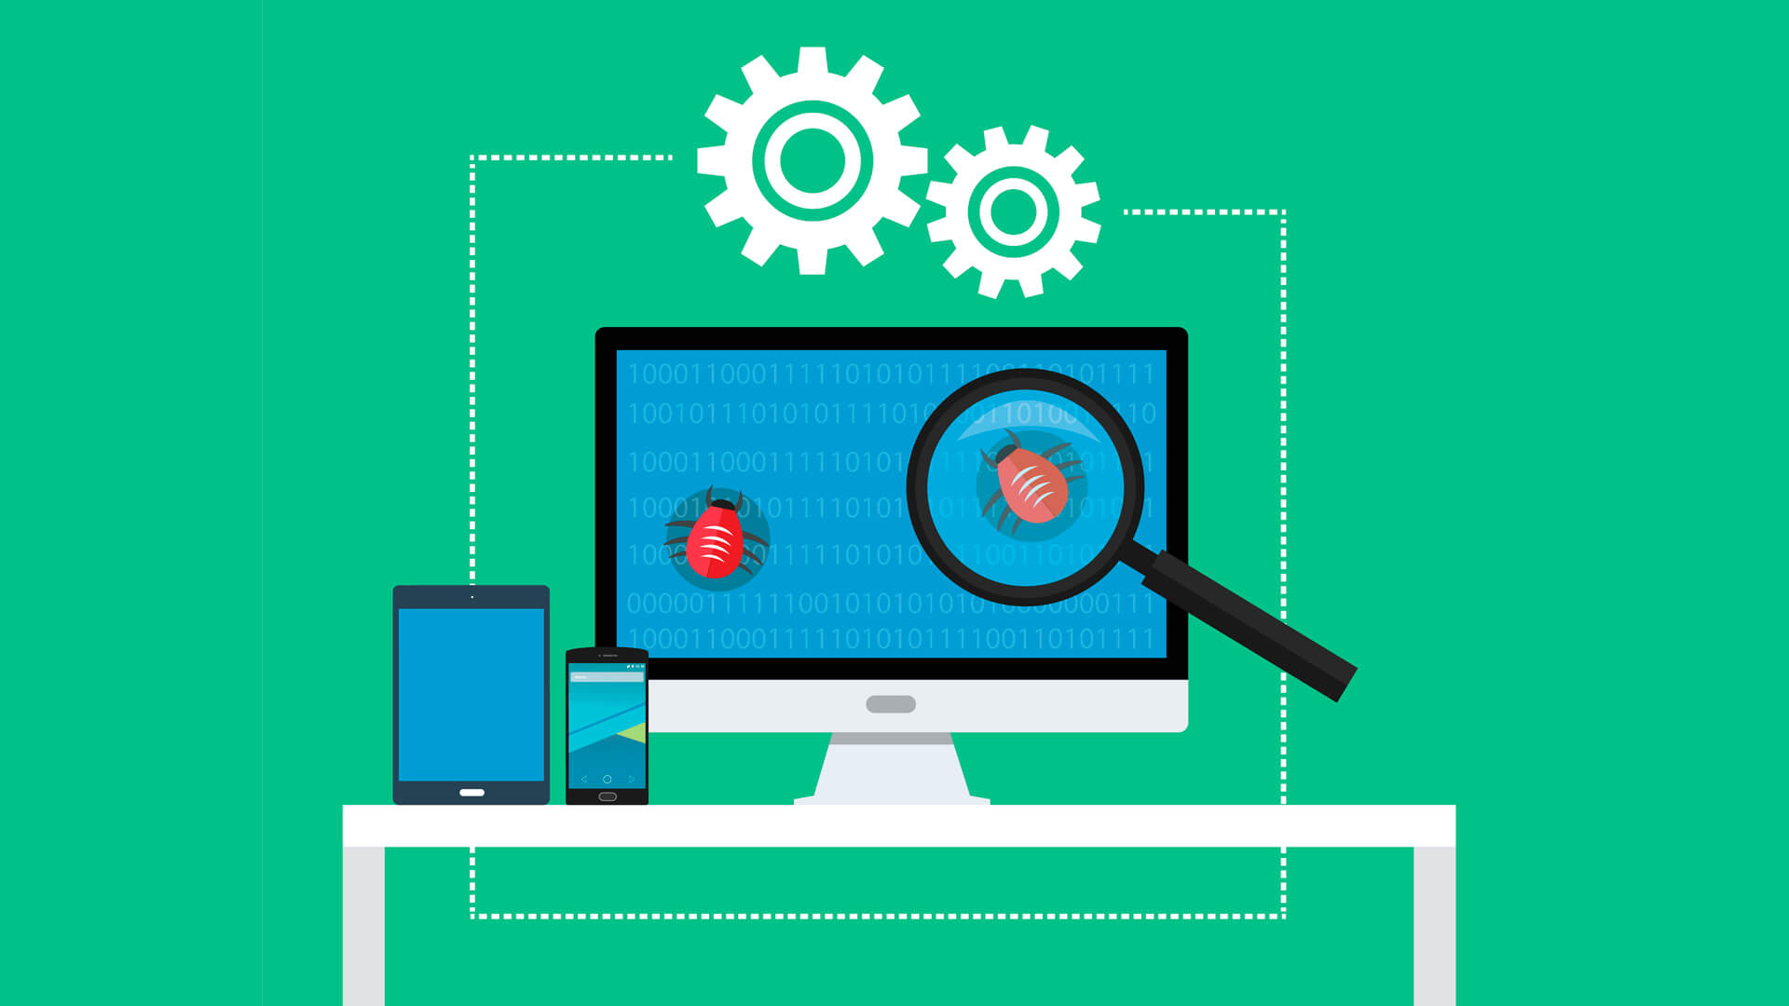
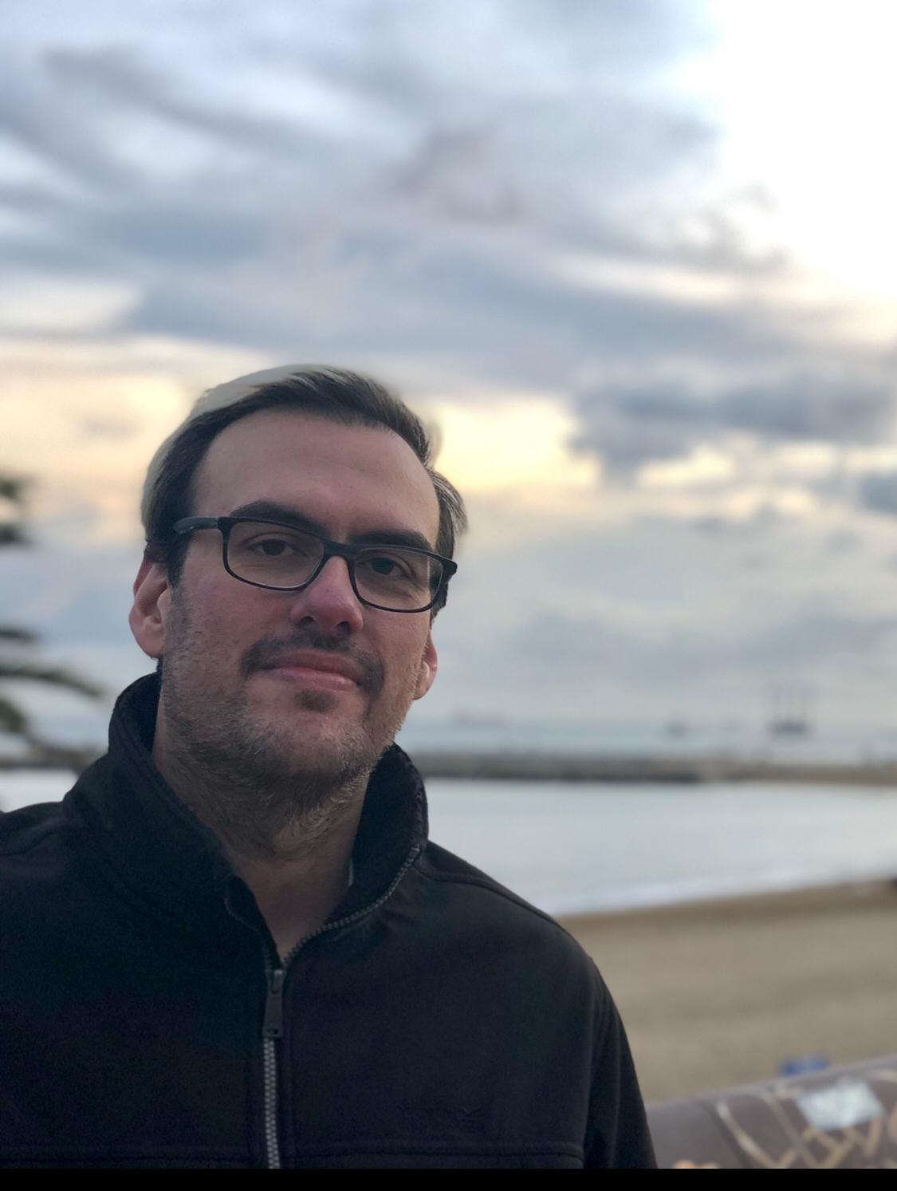
Name : Rui Ranito
Role : Tester

Slide 5


Why we chose this topic/app.
Integration
Autonomy

Slide 6
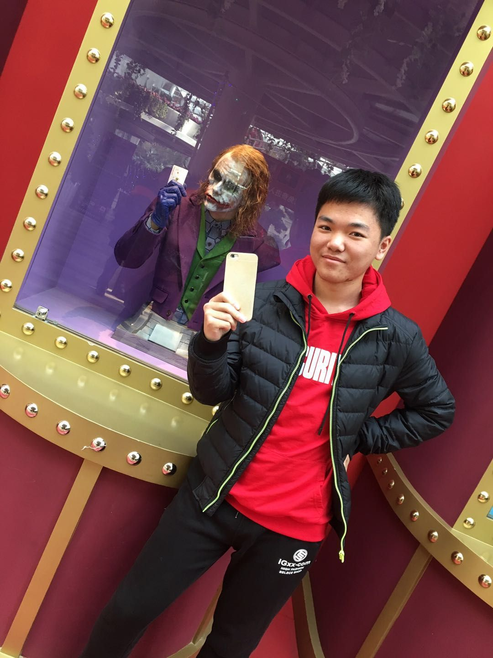

Name : Jiyuan Liu
Role : Documenter

Slide 7


What stood out to us about this project?
Money is one of the most important things in daily life
Spend money appropriately and safely

Slide 8
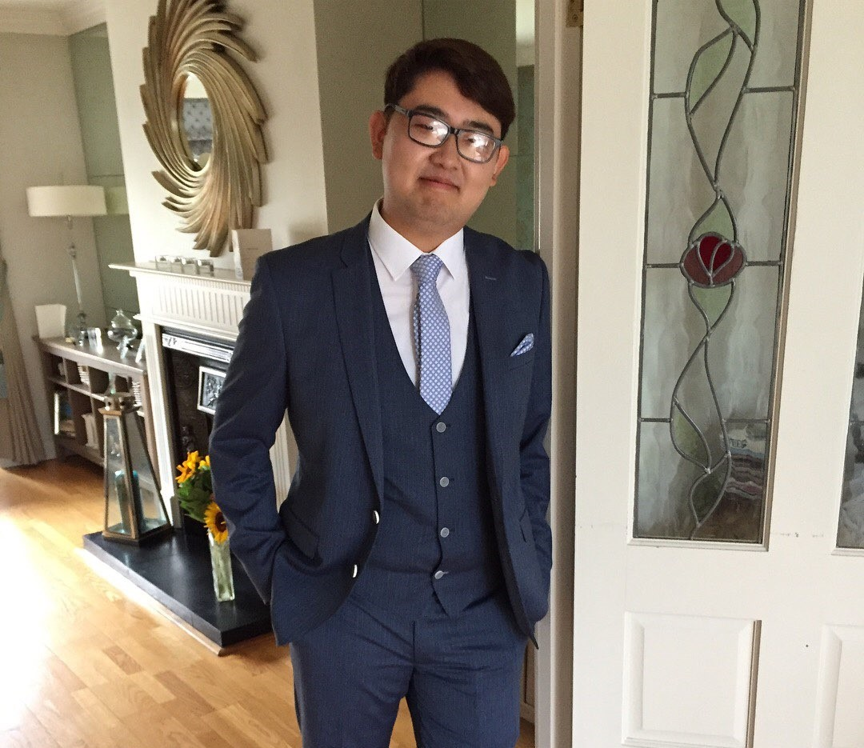
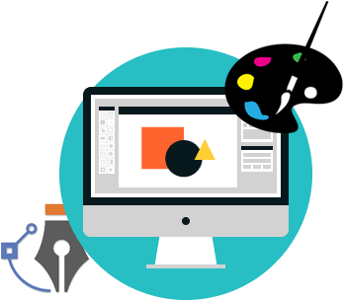
Name : Richard Zou
Role : Designer

Slide 9
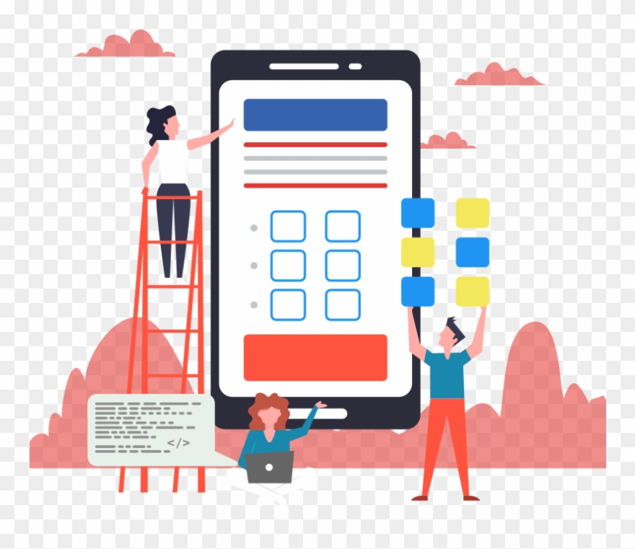

Design
Simplicity
Features

Slide 10

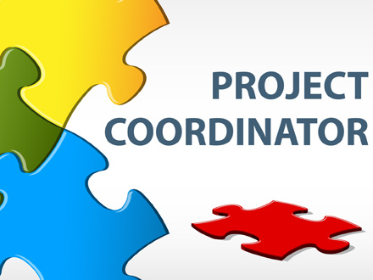
Jake Bolger
Role: Team Coordinator

Slide 11




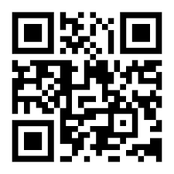
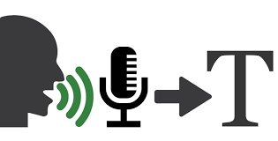

Health & Fitness

Slide 12
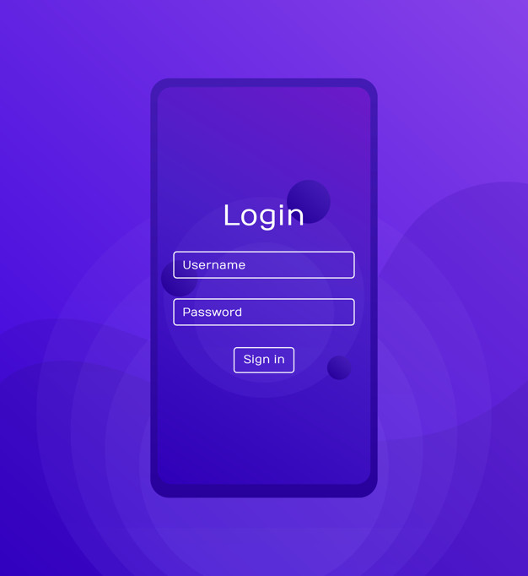


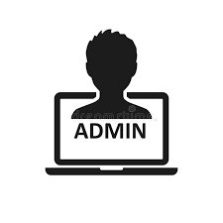

Sign in Registrar

Slide 13
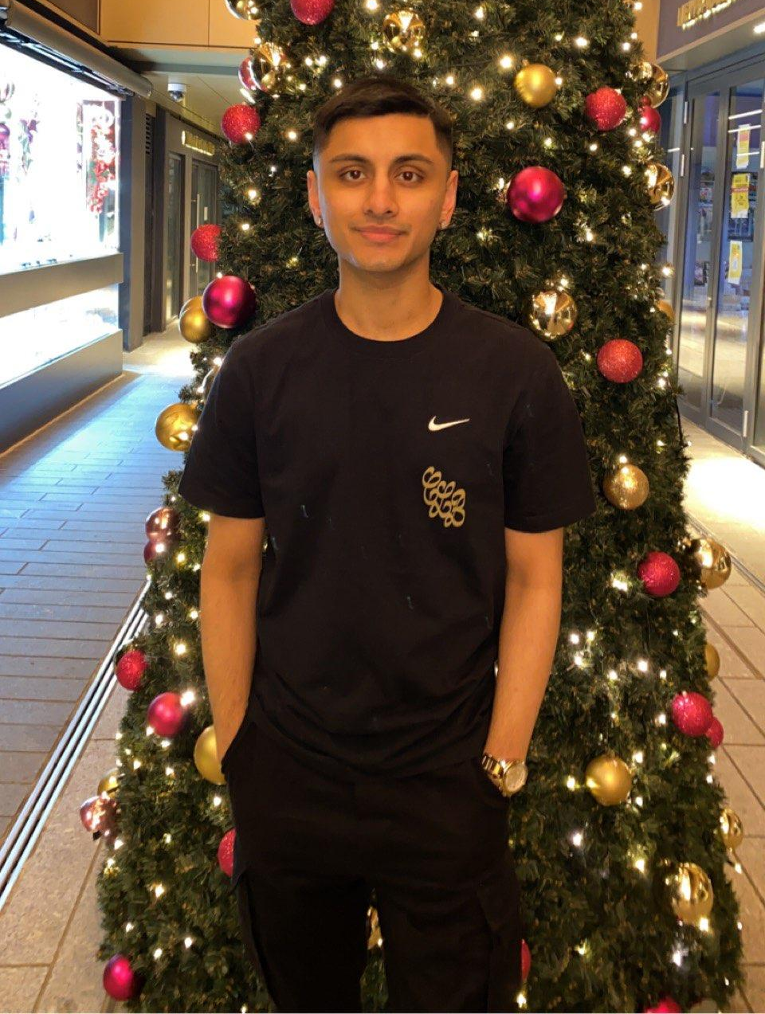
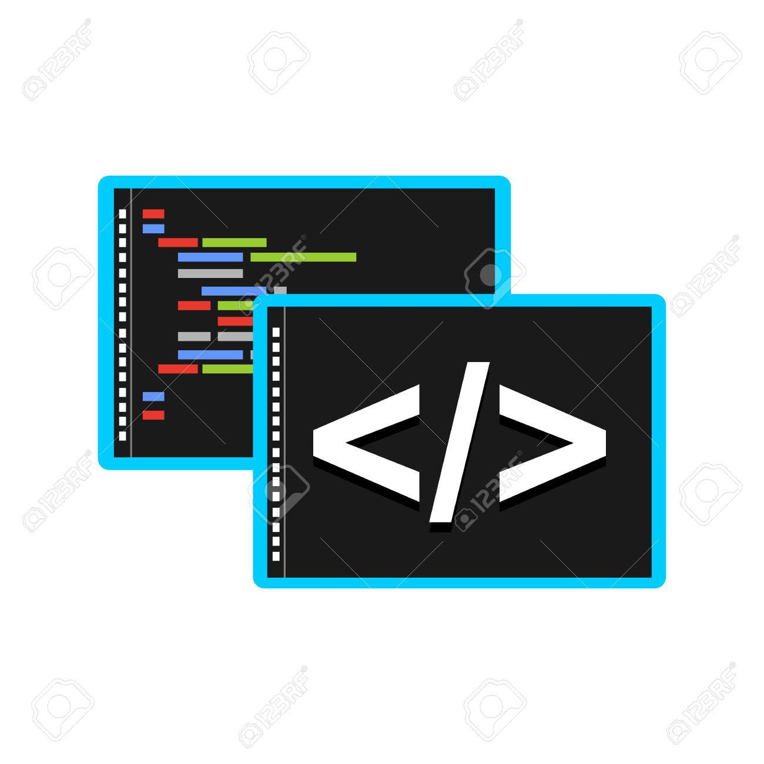
Name : Ishaan Rawat
Role : Coder

Slide 14

Brief Overview

Slide 15


We want this topic because:
Independence is a right!

Slide 16


We are passionate to help you!
Simplicity is key!
Many images

Slide 17

Any Questions?

Slide 18
Thank You For Your Time!

Slide 19
Presentation 2
Design Defence

Slide 20
AtomiX
“Team Two”

Slide 21
Name : Richard Zou
Role : Designer

Slide 22
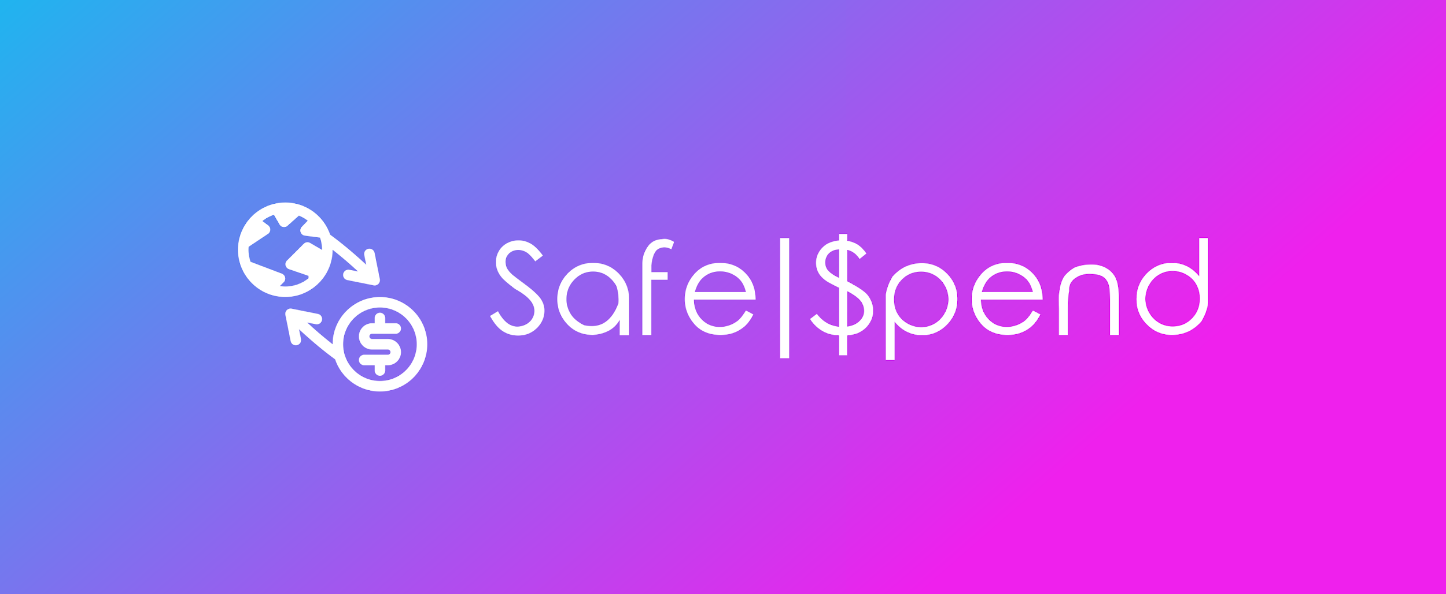
Design for our App

Slide 23
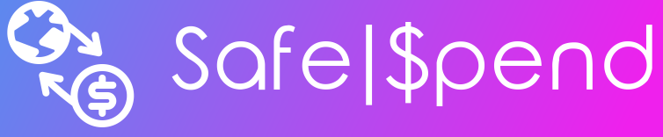
Name: Enoch Oppong
Role: Planner
Money App: Safe|$pend

Slide 24





Requirements
Development of the app Android Studio & Java
Development of code Github
Development of documentation Google Drive Folder

Slide 25
Name : Ishaan Rawat
Role : Coder

Slide 26
Assumptions & Dependencies
Application will be developed on Android Studio
Android will be the Operating System

Slide 27

Issues
Technical limitations
Must focus on images/symbols rather than text!

Slide 28


End-user characteristics
Users have little to no literacy skills
Must use assistive features e.g TEXT-TO-SPEECH

Slide 29

Probable changes in functionality
May introduce a face recognition system
Would this be beneficial?

Slide 30
Name : Jiyuan Liu
Role : Documenter

Slide 31
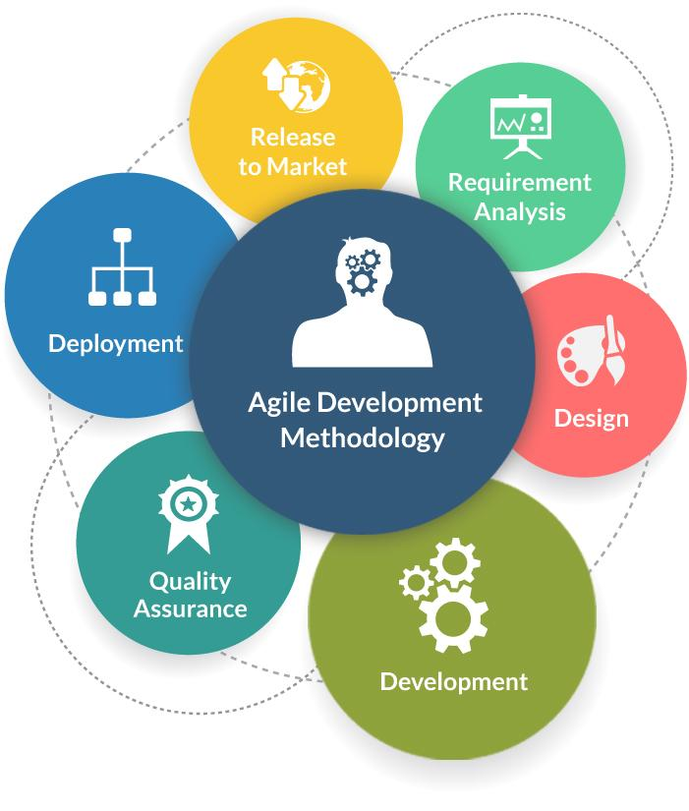
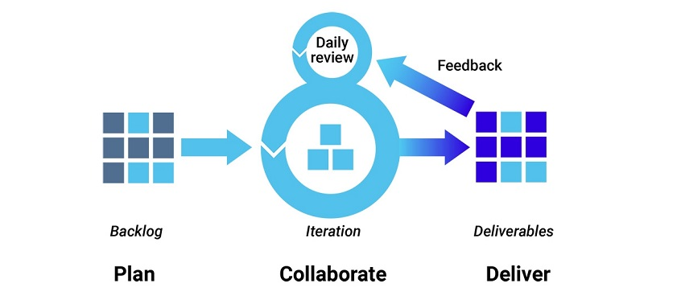
Agile Development Method
Accommodate changes
Communication is important

Slide 32
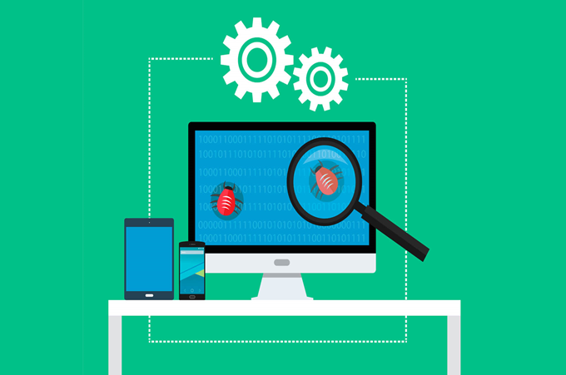

Name : Rui Ranito
Role : Tester

Slide 33






High-Level System Architecture
Money Image Inserted
User
Interface
Image Process
Info Process
Display Message / Money image

Slide 34
System Design Process
Jake Bolger - Team Coordinator
Client Feedback

Slide 35
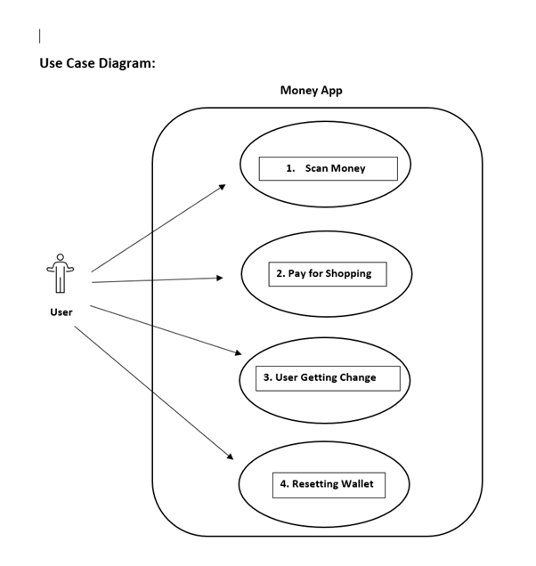
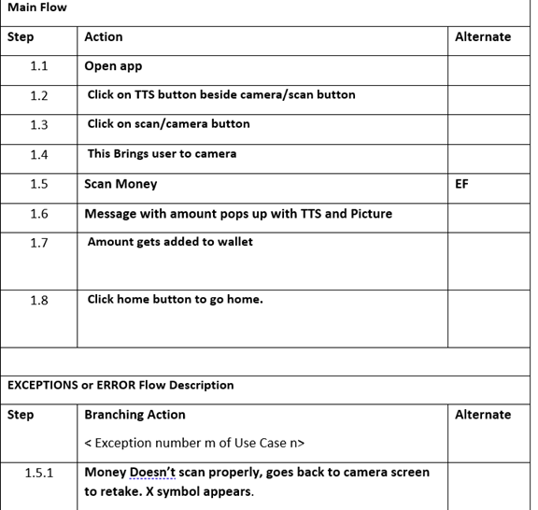
Jake Bolger - Use Case

Slide 36
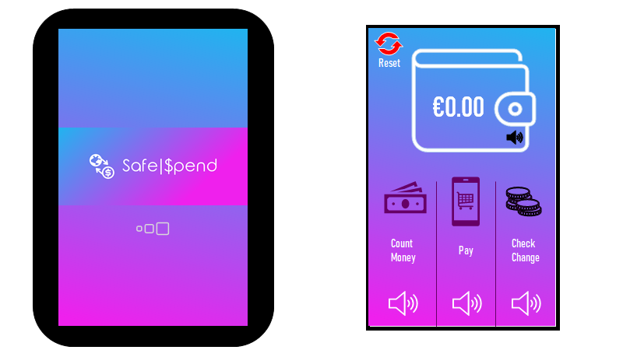
GUI - Jake Bolger
1
Home Screen
2

Slide 37
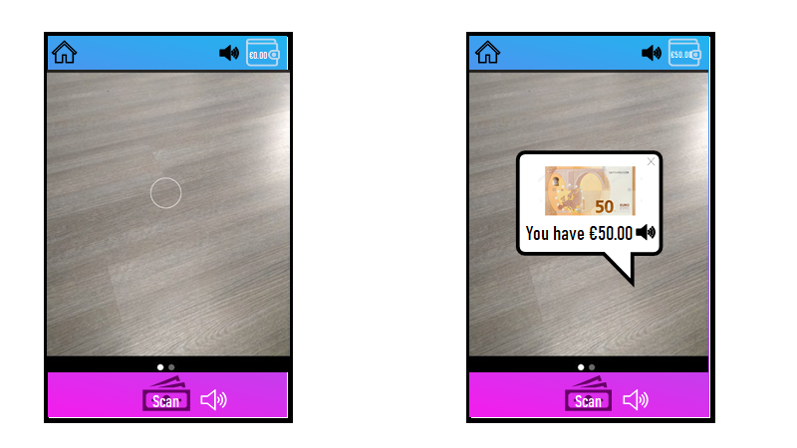
GUI - Jake Bolger
3
Count money
4

Slide 38
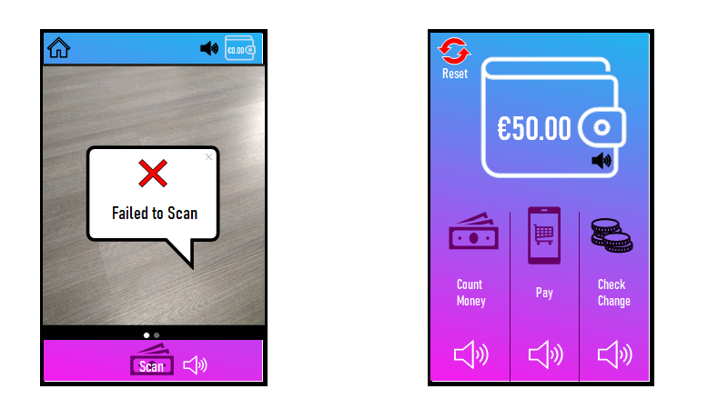
GUI - Jake Bolger
5
6
Money Added

Slide 39
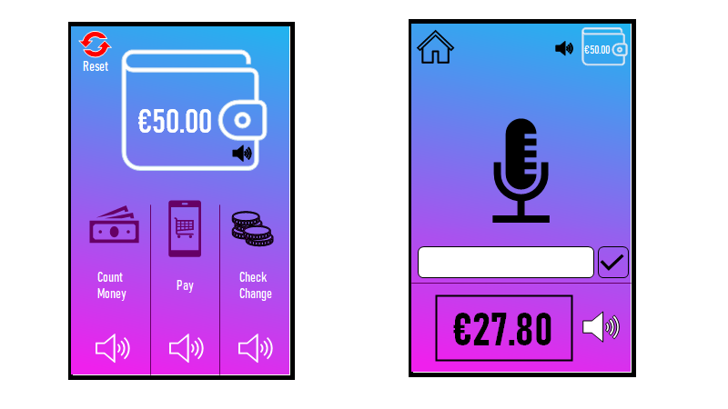
GUI - Jake Bolger
7
8
Paying for Items

Slide 40
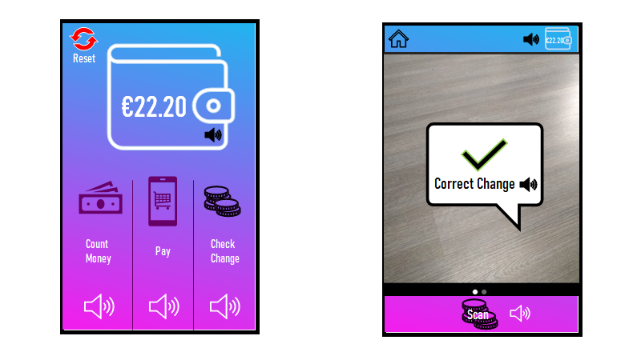
GUI - Jake Bolger
9
10
Money subtracted
Checking change

Slide 41
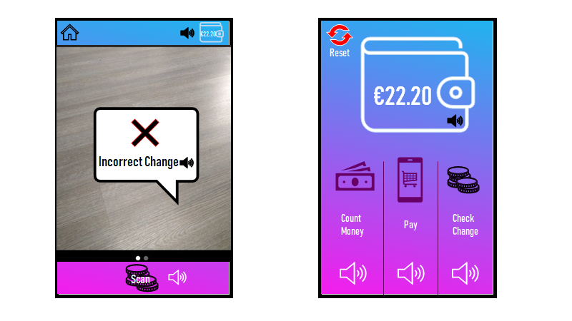
GUI - Jake Bolger
11
12
Show incorrect

Slide 42
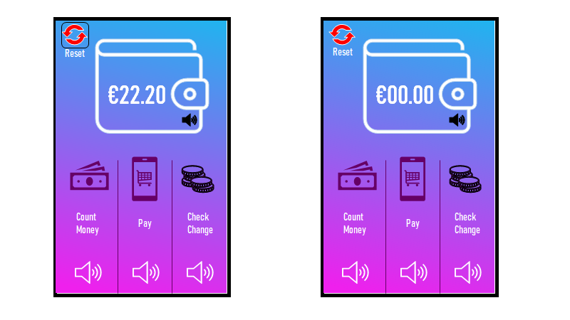
GUI - Jake Bolger
13
14
Reset to Zero

Slide 43
Presentation 3
Project Risk Assessment

Slide 44
Team 2 - AtomiX

Slide 45
Project Plan & Risk Management
Approach - Agile
Detailed sections
Risks
Phases
Requirements
Design
Plan
Risks
Implementation
Testing Phase
Notes:
Proposed Approach
Introduce
Interlink this with all the sections
Talk about phases
Briefly talk about the risks
deal with risks etc

Slide 46
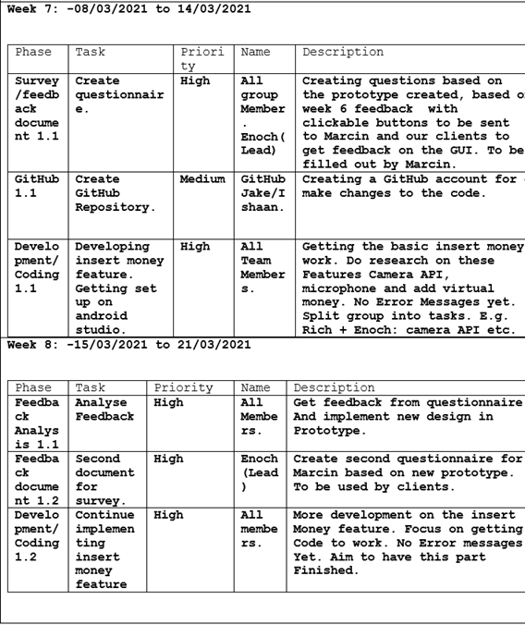
Schedule Plan
Week’s 1-6
Week’s 7-12
Includes Spring Break
Notes:
Surveys/Feedback Documents & Analysis
Github
Developments/Coding
Design
Error phase
Testing

Slide 47
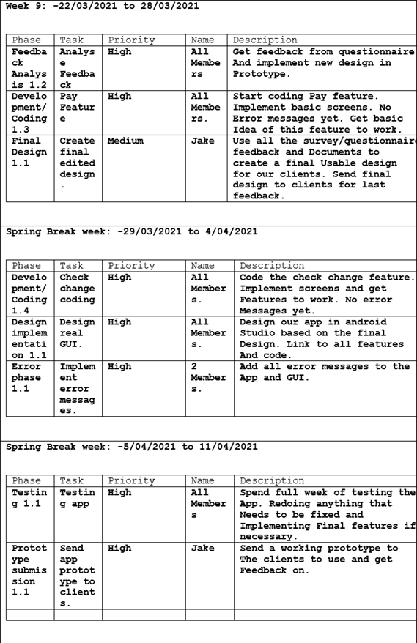
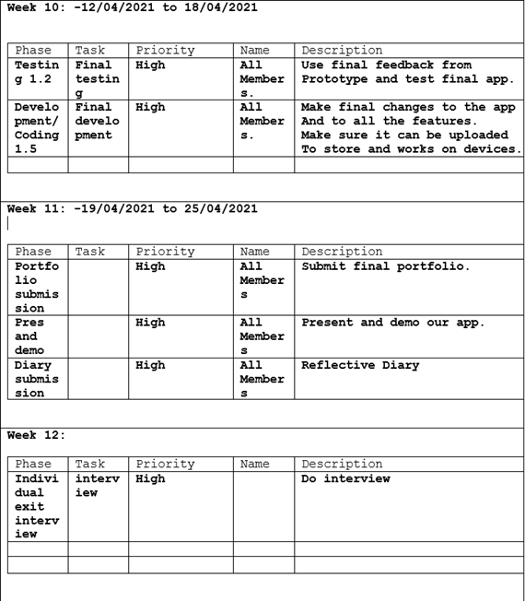

Slide 48

Requirement Phase
Preferences of clients and co-designer
Feedback of the prototype
Period: Week 1 – Week 5

Slide 49

Risks in Requirement Phase
Limitations of information sources
Clients do not fully express their views
Client satisfaction with the prototype

Slide 50
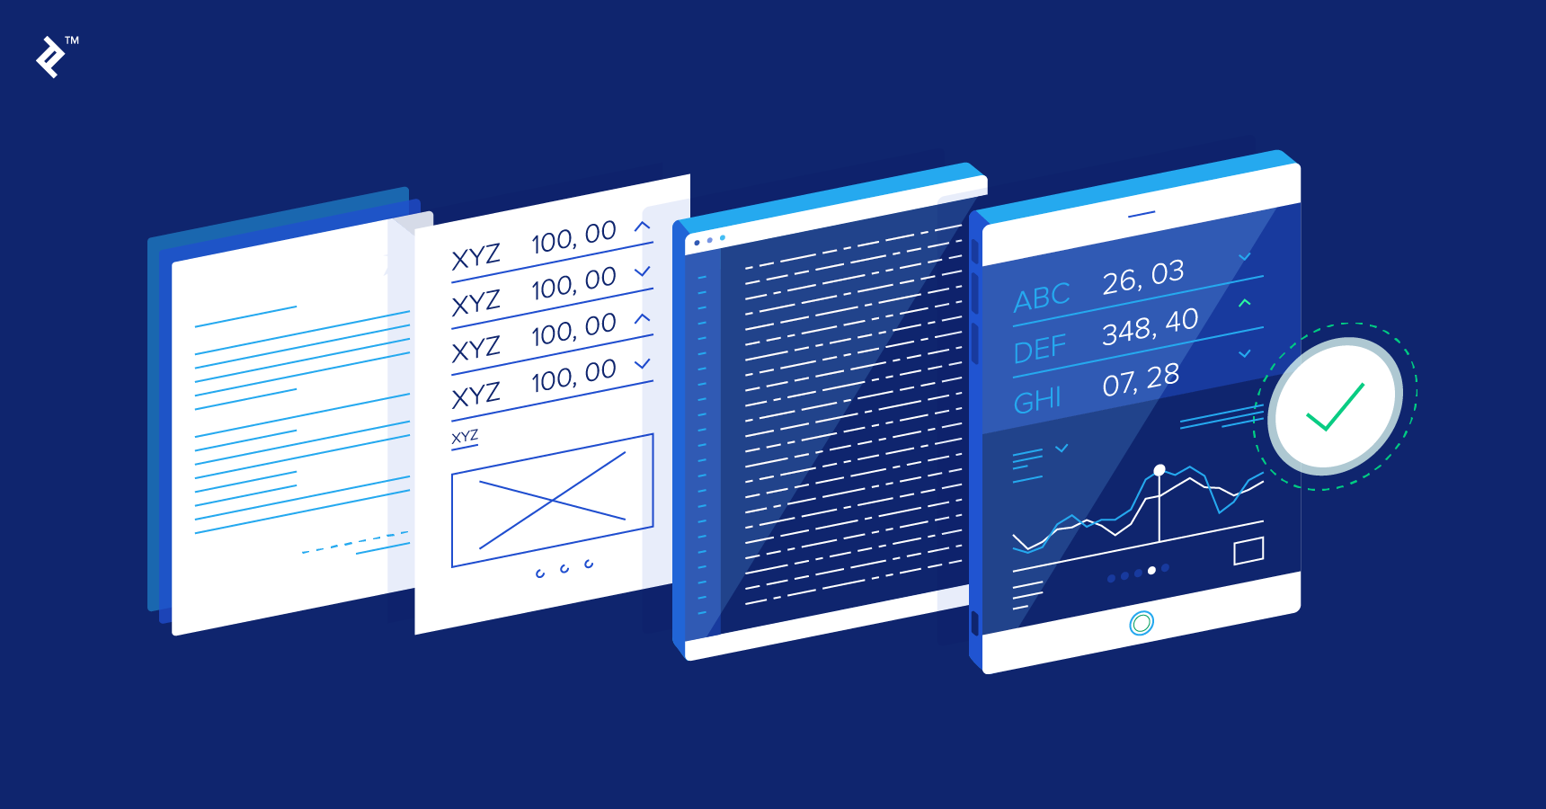
Design
Design Document
Use Case Diagram
Risks?
Implementation!

Slide 51
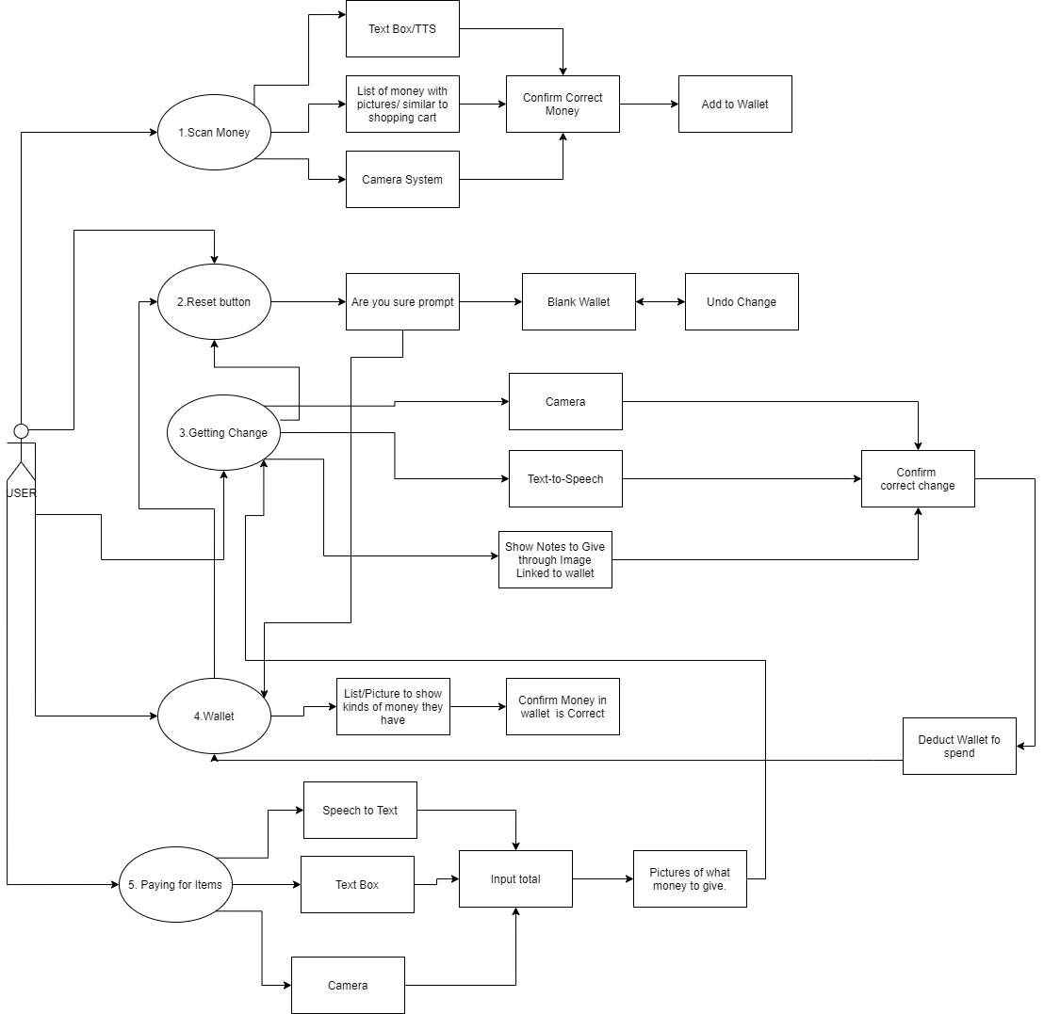
Use Case

Slide 52
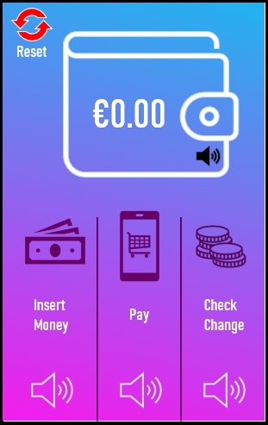
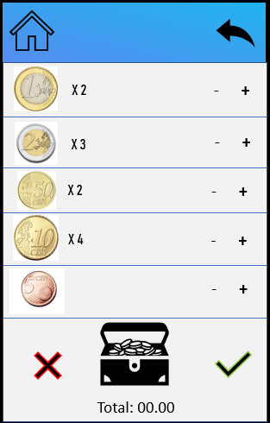
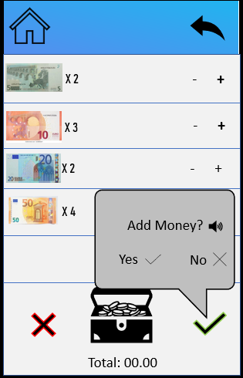
Prototypes
Using Feedback from Clients

Slide 53

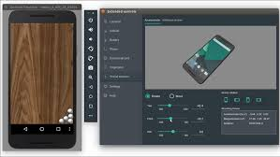
Implementation
Java
Android Studio
Android Emulator
Notes:
Communication aspect risks
Risks for our clients using the survey
Feedback from clients last week.

Slide 54


Problems with Implementation phase
Losing progress
Github
Making application that doesn’t favour clients
Notes:
how we will deal with the risks
dates
anything important

Slide 55
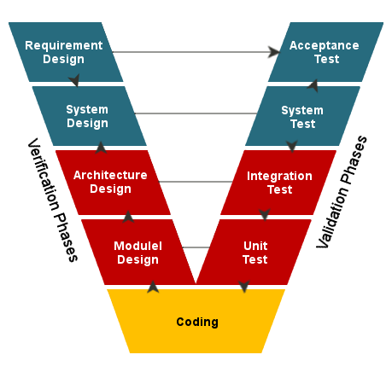
Testing Phase
Test Objective
V Model
CheckList
Problems in testing phase
Notes:
Checklist
Prototype testing
Risks
how you will deal with them
dates

Slide 56
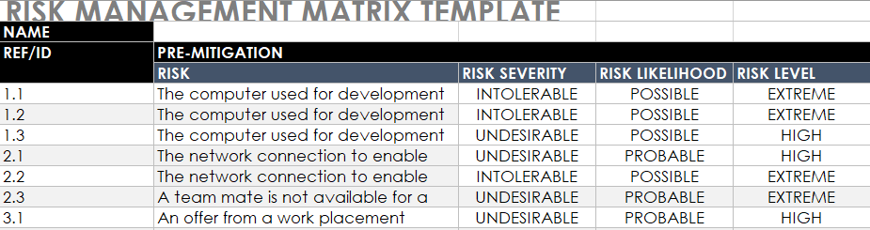
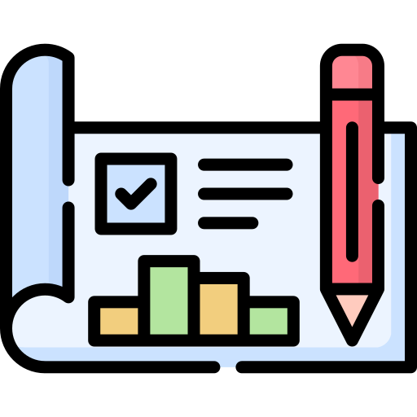
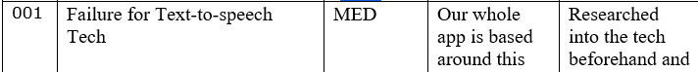
Contingency Plan & Risk Register
External Issues
Internal Issues

Slide 57

To Conclude!
Everything + More

